Slide 1
J2EE Architecture

Slide 2
What is Architecture
Architecture is the overall structure of a system, and it can contain subsystems that interface with other subsystems

Slide 3
The Java™ 2 Platforms
There are three platforms of the Java programming language
  Java Platform, Standard Edition (Java SE)
  Java Platform, Enterprise Edition (Java EE)
  Java Platform, Micro Edition (Java ME)

Slide 4
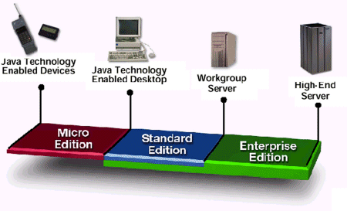
The Java™ 2 Platforms

Slide 5
What is J2EE?
J2EE is Java 2 Enterprise Edition.
Defines the standard for developing multitier enterprise applications.
A set of integrated Java APIs that enable client server Web applications

Slide 6
Overview of Enterprise Applications
As stated above, the Java EE platform is designed to help developers create large-scale, multi-tiered, scalable, reliable, and secure network applications.
A shorthand name for such applications is “enterprise applications,” so called because these applications are designed to solve the problems encountered by large enterprises.

Slide 7
Tiered Applications
In a multi-tiered application, the functionality of the application is separated into isolated functional areas, called tiers.
Typically, multi-tiered applications have a client tier, a middle tier, and a data tier

Slide 8
The Client Tier
The client tier consists of application clients that access a Java EE server and that are usually located on a different machine from the server.
The clients make requests to the server. The server processes the requests and returns a response back to the client.

Slide 9
The Web Tier
The web tier consists of components that handle the interaction between clients and the business tier.
Its primary tasks are the following:
Dynamically generate content in various formats for the client.
Collect input from users of the client interface and return appropriate results from the components in the business tier.
Control the flow of screens or pages on the client.
Maintain the state of data for a user's session.
Perform some basic logic and hold some data temporarily in JavaBeans components.

Slide 10
Business Tier
The business tier consists of components that provide the business logic for an application.
Business logic is code that provides functionality to a particular business domain, like the financial industry, or an e-commerce site.
In a properly designed enterprise application, the core functionality exists in the business tier components.

Slide 11
The Enterprise Information Systems Tier (or) Data Tier
The enterprise information systems (EIS) tier consists of database servers, enterprise resource planning systems, and other legacy data sources, like mainframes.
These resources typically are located on a separate machine than the Java EE server, and are accessed by components on the business tier.

Slide 12
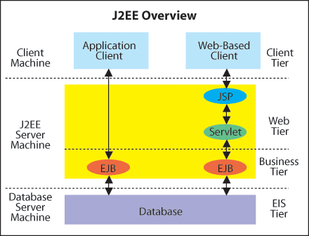

Slide 13
Main technologies
JavaServer Pages (JSP)
Servlet
Enterprise JavaBeans (EJB)
Notes:
_{<number>}

Slide 14
JSP
Used for web pages with dynamic content
Processes HTTP requests (non-blocking call-and-return)
Accepts HTML tags, special JSP tags, and scriptlets of Java code
Separates static content from presentation logic
Can be created by web designer using HTML tools
Notes:
_{<number>}

Slide 15
Servlet
Used for web pages with dynamic content
Processes HTTP requests (non-blocking call-and-return)
Written in Java; uses print statements to render HTML
Loaded into memory once and then called many times
Provides APIs for session management
Notes:
_{<number>}
Actually, an HTTP servlet processes HTTP requests.
APIs for maintaining session data throughout a web application and interacting with the user request ➔ overcomes the limitation of the stateless nature of HTTP.

Slide 16
EJB
EJBs are distributed components used to implement business logic (no UI)
Developer concentrates on business logic
Availability, scalability, security, interoperability and integrability handled by the J2EE server
Client of EJBs can be JSPs, servlets, other EJBs and external aplications
Clients see interfaces
Notes:
_{<number>}

